Slide 1
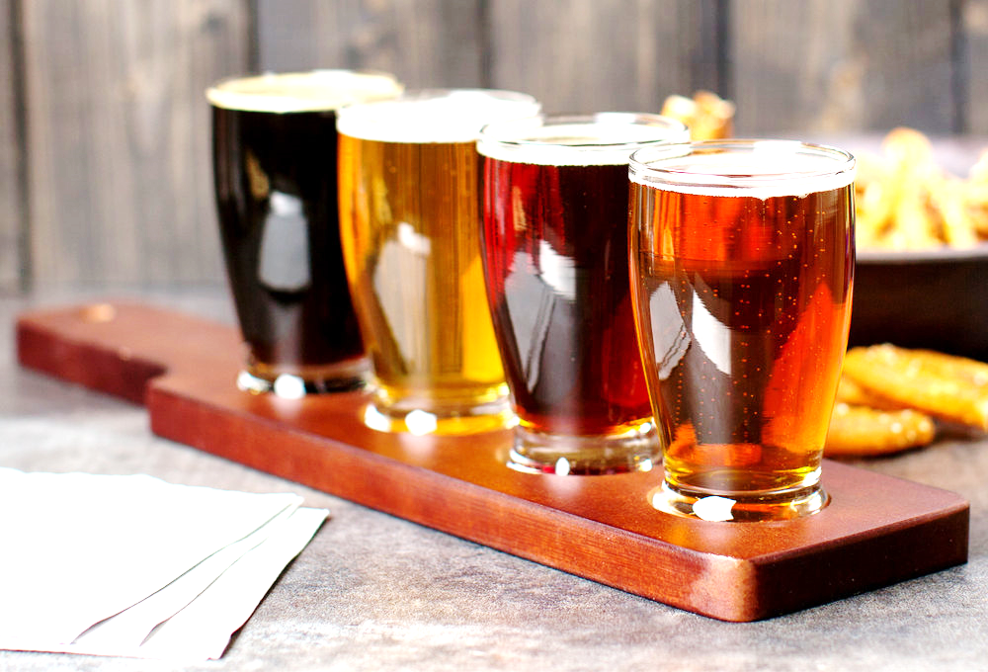
Tasting Descriptors
How to Describe What’s in Your Glass

Slide 2
What are we NOT talking about?
Judging
Specific Styles
What is Good or What is Bad
What You Like or Don’t Like

Slide 3
What are we talking about?
What do you see?
What do you smell?
What do you taste?
How do you describe these things?
How can you use other experiences to taste?

Slide 4
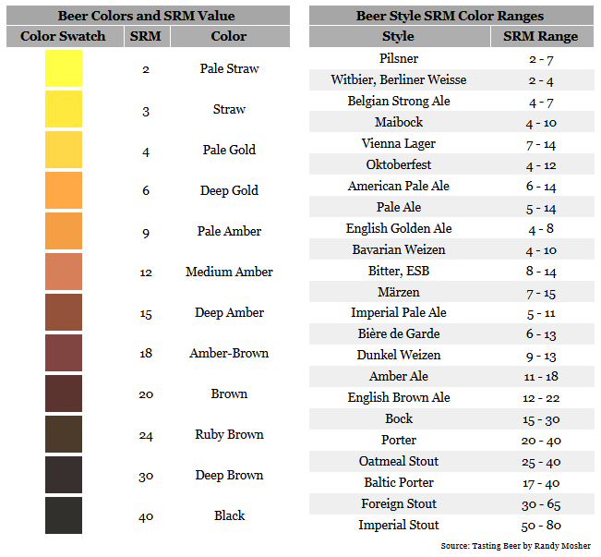
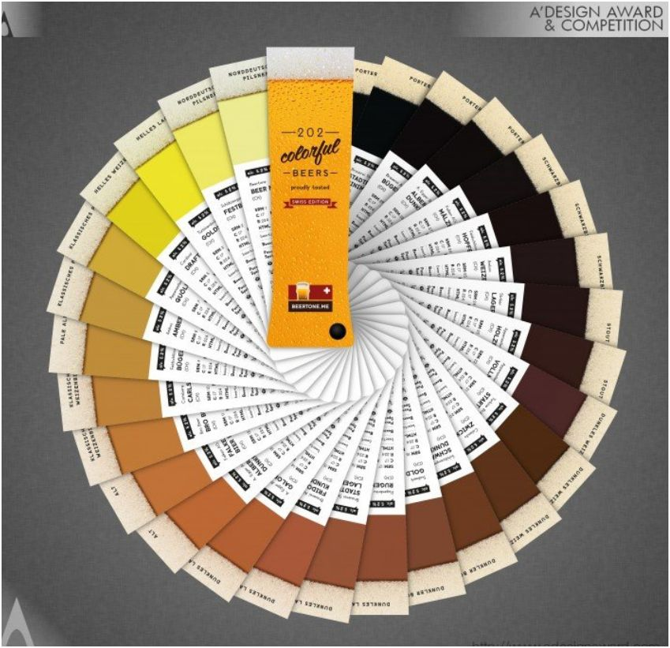
What do you see?

Slide 5
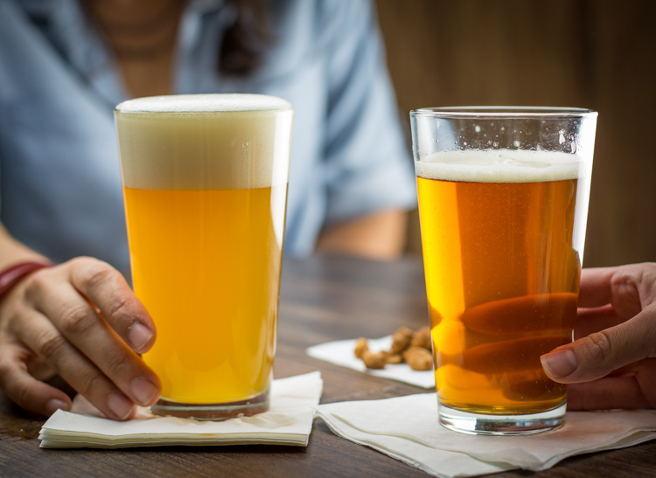
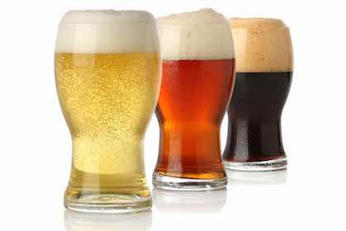
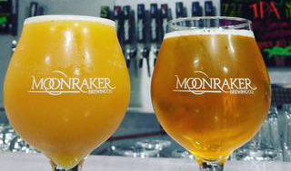
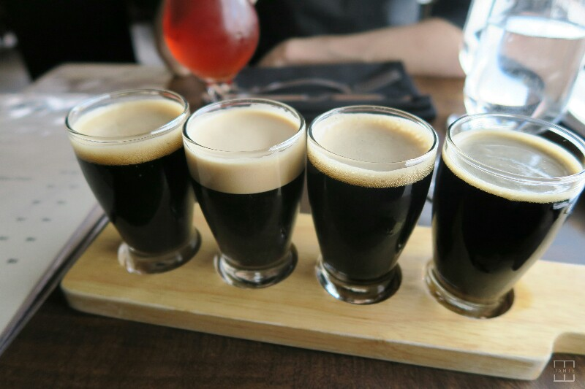

Slide 6
What do you see? Words
Color | Head | Clarity | Carbonation
Black | Bright White | Brilliant | Still
Coffee | Dissipating | Clear | Flat
Chocolate | Fluffy | Dull | Dull
Brown | Frothy | Opaque | Bubbly
Amber | Lingering | Sparkling | Lively
Maple | Off White | Hazy | Effervescent
Ruby | Persistent | Cloudy | Gusher
Auburn | Rocky | Turbid
Russet | Tan
Copper | Thin
Tan | Creamy
Orange
Gold
Honey
Straw
Clear
Vibrant

Slide 7
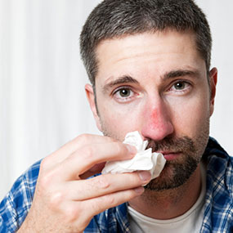
What do you Smell?
Why is smelling important?
Is this you?

Slide 8
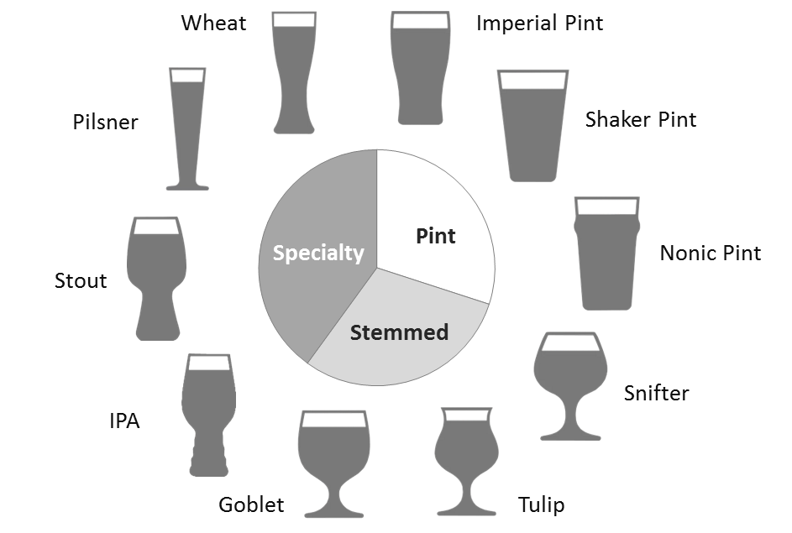
Glasses

Slide 9
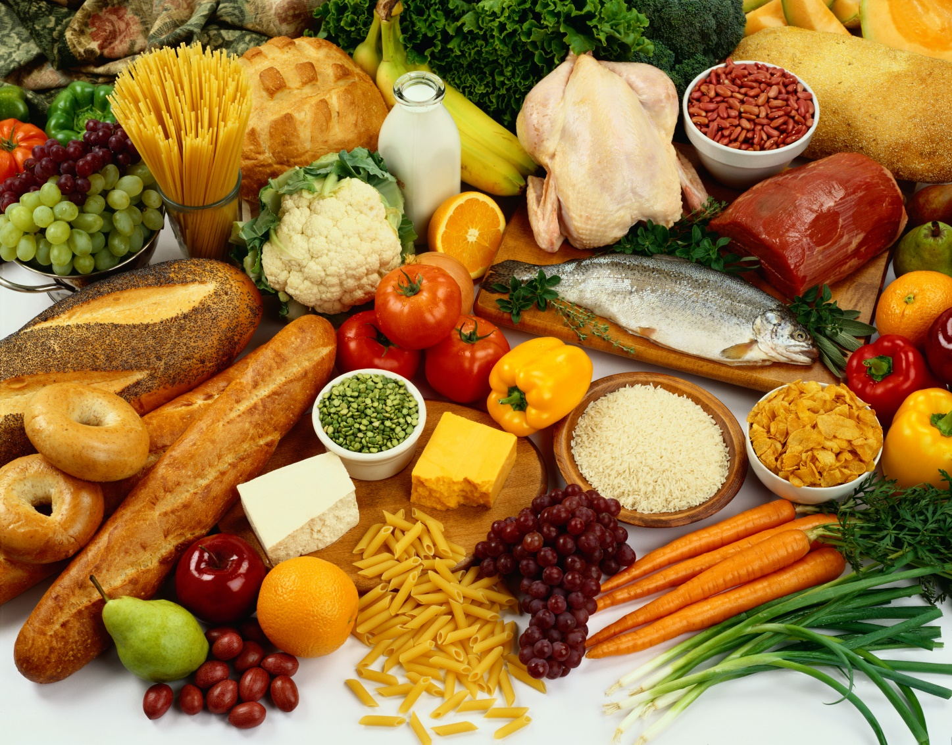
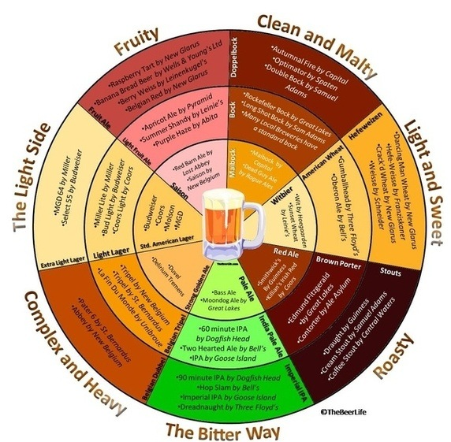
What do you Taste?

Slide 10
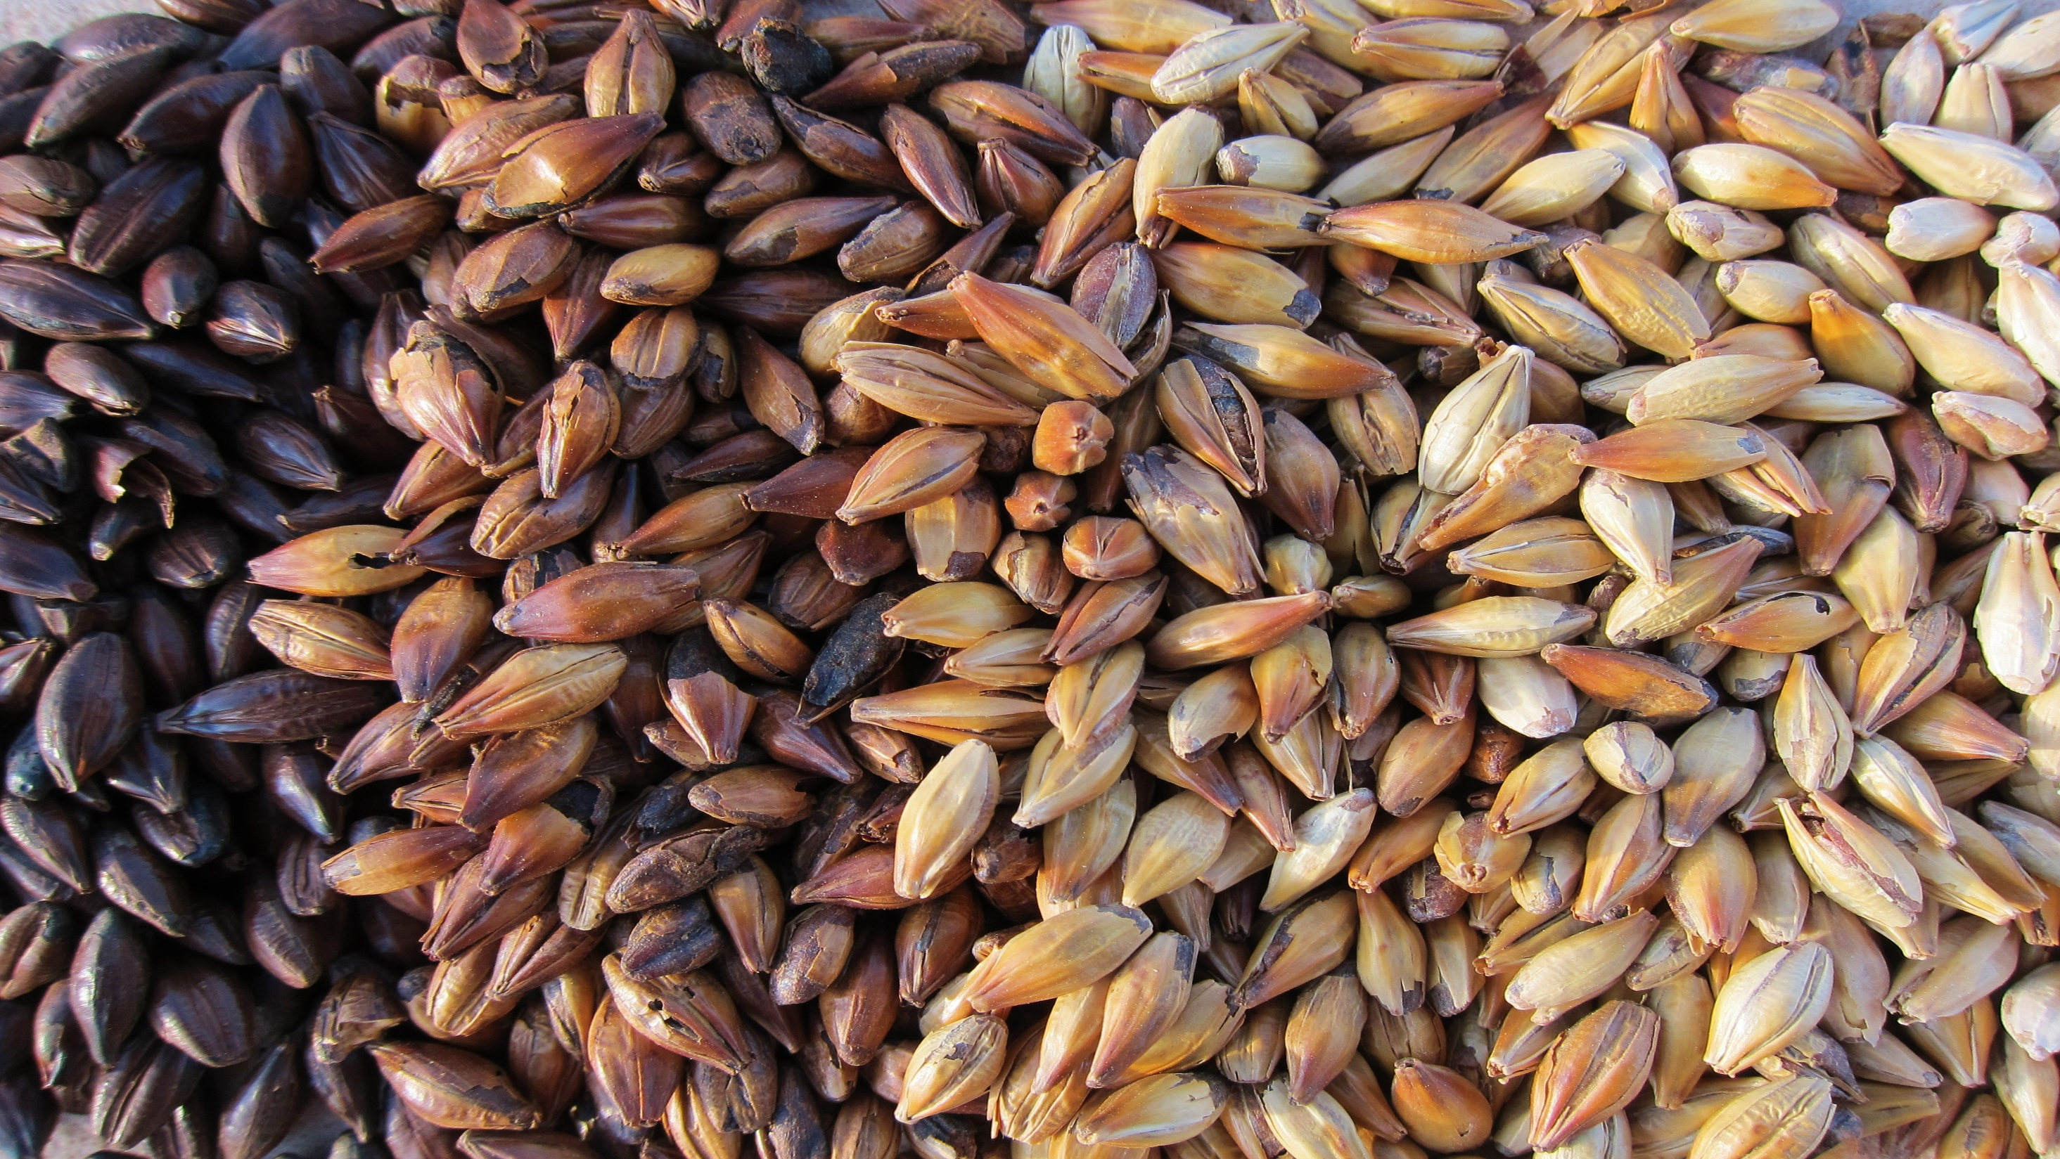
Flavor and Aroma
Malt
Animal Cracker | Blackberry | Caramel | Dough
Biscuit | Blueberry | Caramelized Sugar | Flour
Bread | Fig | Chocolate | Grainy
Bread Crust | Oatmeal | Coffee | Granola
Pumpernickel | Plum | Dark Chocolate | White Bread
Rye | Prune | Honey | Cracker
Burnt | Raisins | Licorice | Vanilla
Cereal | Saltine | Maple | Peaty
Charcoal | Spicy | Milk Chocolate | Dark Fruit
Charred | Toast | Molasses
Corn | Toffee | Nutty

Slide 11
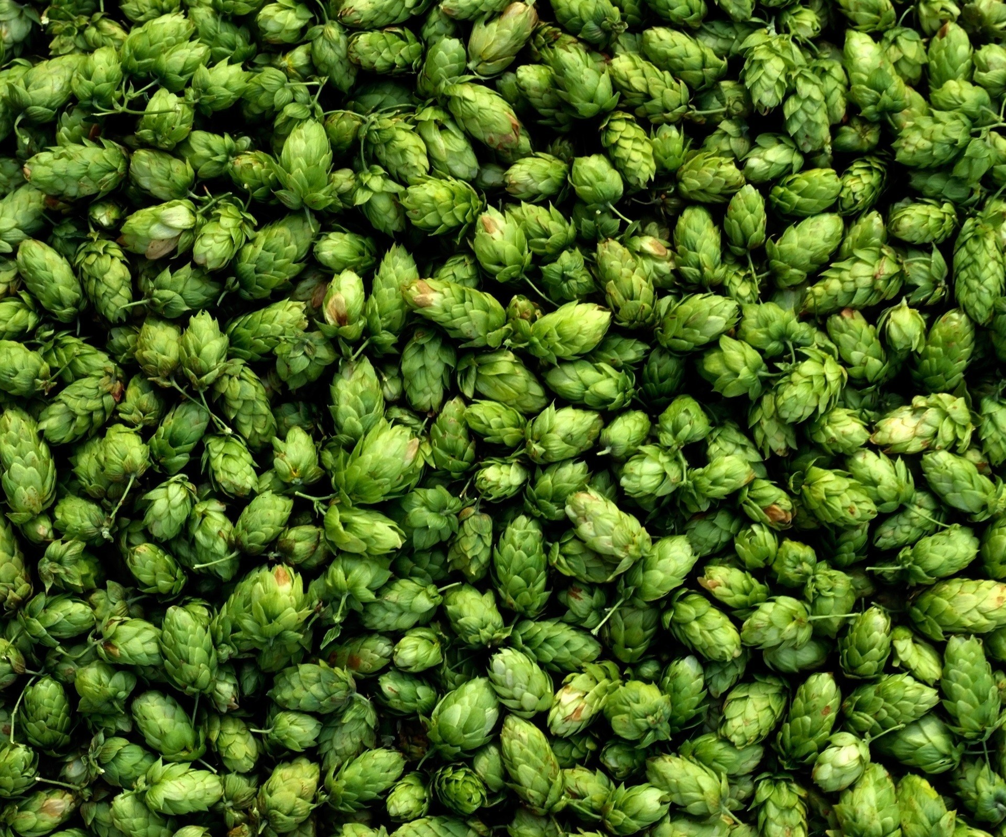
Flavor and Aroma
Hops
Dank | Nutty | Onion | Catty
Earthy | Orange | Garlic | Cat Piss
Floral | Passion Fruit | Mowed Lawn | Woody
Grapefruit | Peppery | Minty | Zesty
Grapes | Perfumy | Lemon | Spicy
Grassy | Piney | Lime | Vegetal
Herbal | Resinous | Bitter | Musky

Slide 12
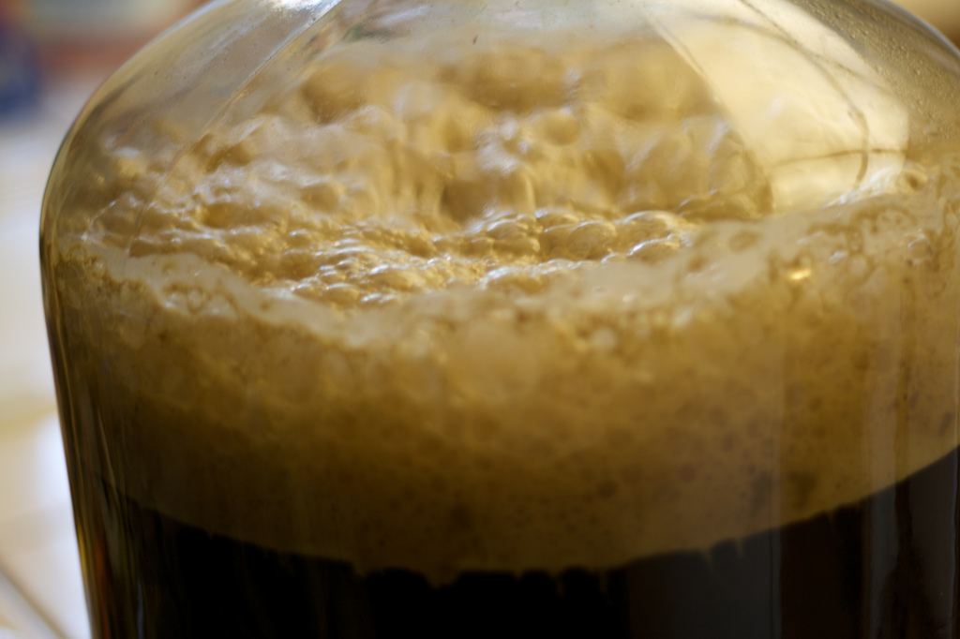
Flavor and Aroma
Yeast
Apple | Dried Fruit | Pear | Apple
Banana | Fruit Bomb | Pinapple | Horse Blanket
Belgian-like | Funky | Rasberry | Green Apple
Blackberry | Hay | Rustic | Pool Toy
Bubblegum | Jammy | Straw | Hot
Candy | Juicy | Strawberry | Alcoholic
Currant | Melon | Allspice | Black Pepper

Slide 13
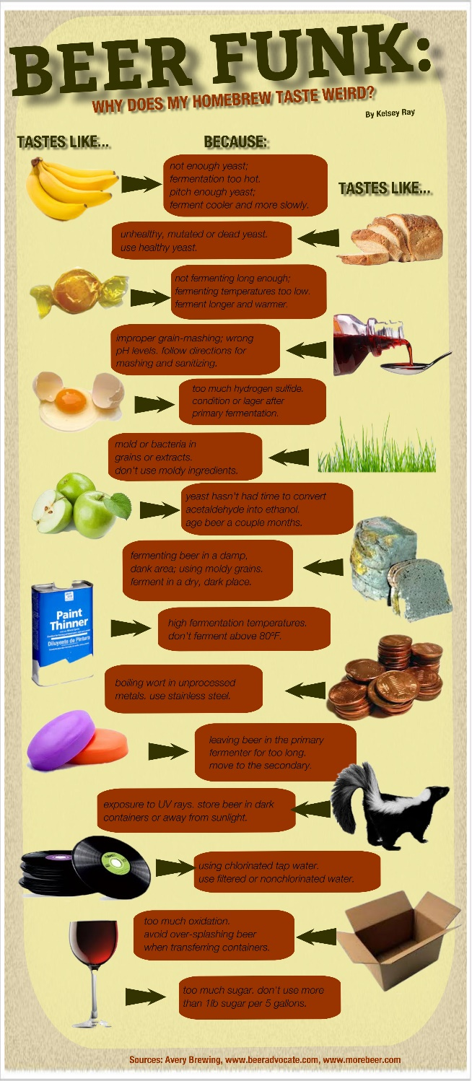
Flavor and Aroma
Off Flavors
Burnt Rubber | Cooked Corn | Sulphur | Celery
Butter | Garlic | Tomato | Solvent
Butterscotch | Onion | Soy Sauce | Skunky
Cardboard | Papery | Cheesy | Catty

Slide 14
Flavor and Aroma
Finish
Astringent | Bitter | Dry | Harsh
Lingering | Quenching | Short Lived | Sour
Sweet | Puckering | Smooth | Watery

Slide 15
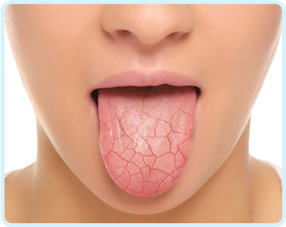
What do you Taste? Mouth Feel
Body | Carbonation | Sensation
Dense | Dull | Acidic | Puckering
Full | Effervescent | Astringent | Sharp
Heavy | Fizzy | Creamy | Silky
Light | Flat | Chewy | Slick
Medium | High | Crisp | Smooth
Robust | Low | Dry | Soft
Thin | Medium | Hearty | Sour
Watery | Overcarbed | Hot | Syrupy
 | Prickly | Metallic | Tart
 | Spritzy | Mouthcoating | Tingly
 |  | Oily | Velvety

Slide 16

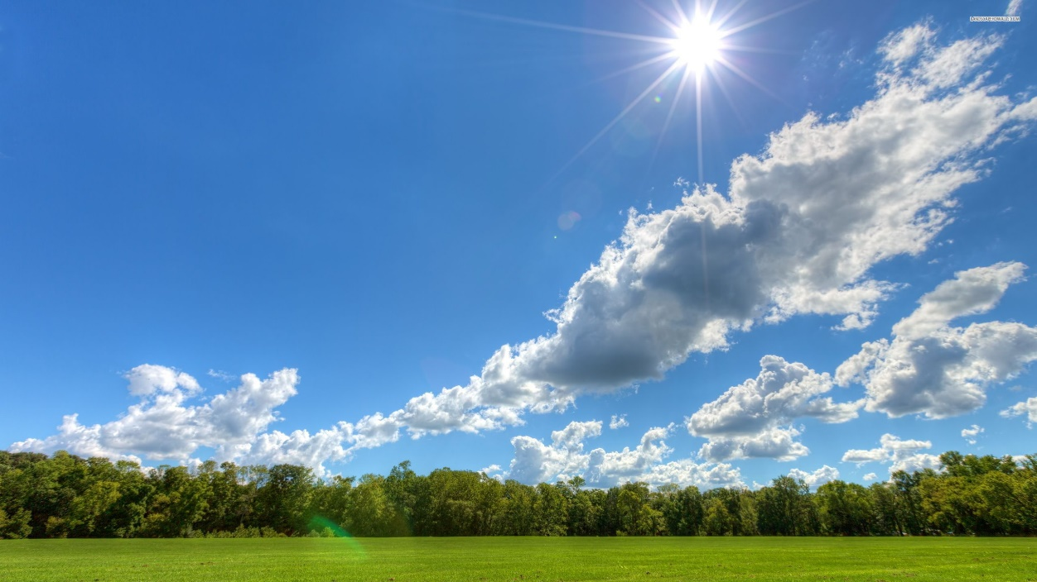
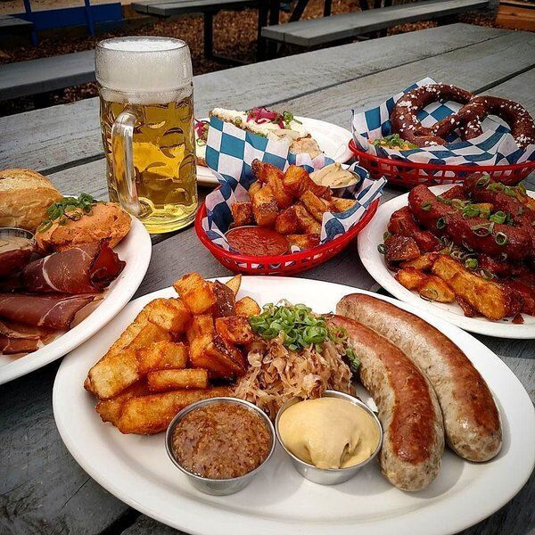
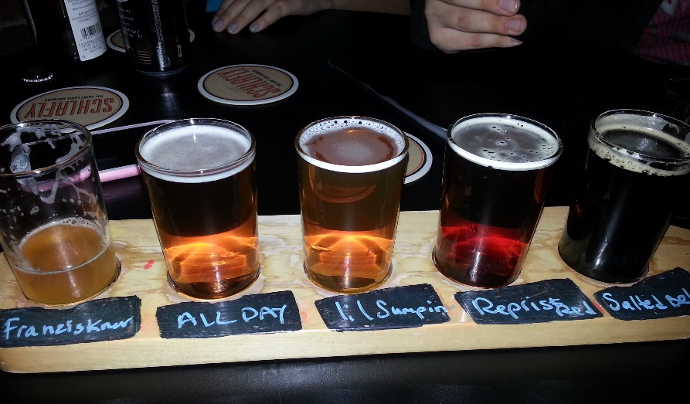
Experience

Slide 17

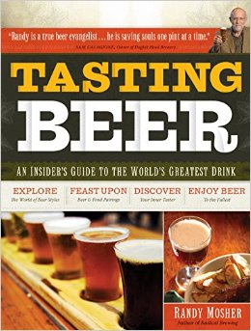

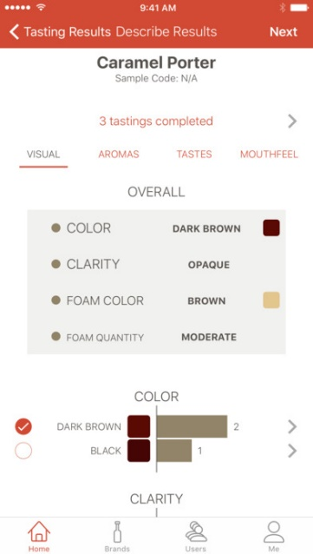
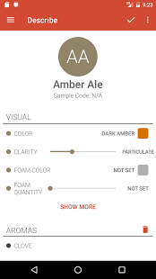
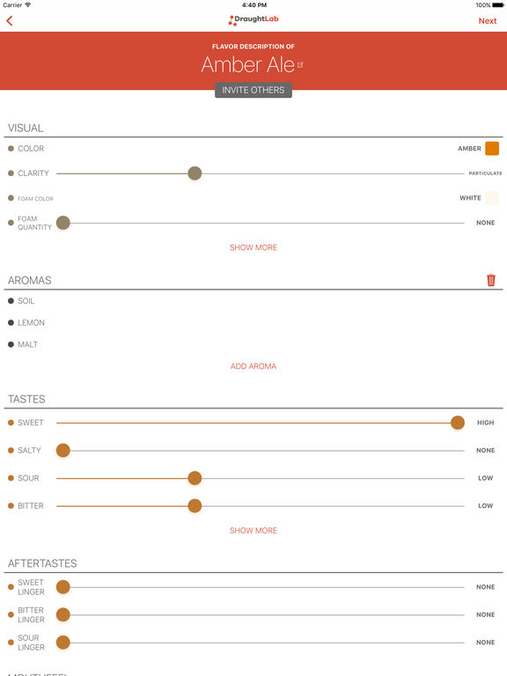
Resources
http://www.beertastingmastery.com/

Slide 18
